Slide 1
ASAPP HACKATHON
TEAM MEMBERS:
20PC04 - AMUTHESHWAR
20PC06 - ANANTHA VIJAY
20PC23 - NEERAJA
20PC25 - NIVEDITA

Slide 2
OUTLINE
The Problem
Solution Proposal
Tools Used
Deliverables

Slide 3
THE PROBLEM

Slide 4
PROBLEM STATEMENT
1: Hallucination Detection
Come up with a system which, given a text and a summary, detects if there were hallucinations present in the summary.
Can you pinpoint the hallucinated part of the summary?
How do we quantize hallucination detection?
General things to cover
1. Design a ML system -- can use 3rd party llms
2. Design prompts
3. Design the engineering orchestration
4. Package it in a small Streamlit/Gradio/React webapp.

Slide 5
SOLUTION PROPOSAL

Slide 6
SOLUTION APPROACH
Start: Begin the process.
Input Conversation Data: Accept input data (conversation_id, speaker, text, and summary_a).
Extract Summary: Extract summary_a from the dataset for a given conversation_id.
Apply LLM Models
Use Gemini to detect hallucinations.
Use Llama to detect hallucinations.
Use Cohere to detect hallucinations.
Aggregate Results: Combine hallucination detection results from all models (majority vote, weighted, etc.).
Inaccuracies Detected?
Yes: Proceed to fix the hallucinations.
No: Output the summary as accurate
Fix Inaccuracies: Use the LLM models to suggest corrections for the hallucinated parts.
Compare Summaries: Calculate the similarity between the original and corrected summaries (e.g., cosine similarity, semantic similarity).
High Similarity?
Yes: Mark the summary as accurate (minimal corrections).
No: Mark the summary as hallucinated (significant changes needed).
Output: Generate the final summary (either original or corrected) and the hallucination detection status.
End: End the process.

Slide 7
UML DIAGRAM

Slide 8
+--------------------------------------------------------------------------------------+
| <<App>> Hallucination Detection System |
| + registerUser() + loginUser() + logoutUser() |
| + uploadConversationData(conversation) |
| + detectHallucination(summary) |
| + fixSummary(summary) + compareSummaries(original, fixed) |
+---------------------------------------------------------------------------------------+
|
V
+-----------------------------------------------------------------------------+
| <<Orchestrator>> LLM Orchestration |
| + detectWithGemini() + detectWithLlama() |
| + detectWithCohere() + aggregateResults(results) |
+-----------------------------------------------------------------------------+
| | |
V V V
+------------+ +-----------+ +--------------+
| <<LLM>>| | <<LLM>> | | <<LLM>>|
| Gemini | | Llama | | Cohere |
+------------+ +-------------+ +------------+
|
V
+-----------------------------------------------------------------------------+
| <<Fixer>> FixInaccurateSummary |
| + fixInaccuracies(summary) + validateFixedSummary() |
+-----------------------------------------------------------------------------+ |
V
+-------------------------------------------------------------------+
| <<Checker>> CompareSummaries |
| + computeSimilarity(original, fixed) |
| + generateReport(similarityScore) |
+-------------------------------------------------------------------+
|
V
+-----------------------------------------------------------------------------+
| <<UI>> UserDashboard |
| + displayLoginScreen() + showSummaryComparison() |
| + displayFixOption() + logoutButton() |
+-----------------------------------------------------------------------------+
|
V
+-------------------------------------------------------------------+
| <<Auth>> AuthenticationController |
| + register() + login() + logout() |
+-------------------------------------------------------------------+

Slide 9
TOOLS USED

Slide 10
TOOLS USED
Python
Flask
Streamlit
Langchain
SQLite

Slide 11
DELIVERABLES

Slide 12
DELIVERABLES
A web application to detect hallucination in summary for a given series of conversion.

Slide 13
SCREENSHOTS

Slide 14
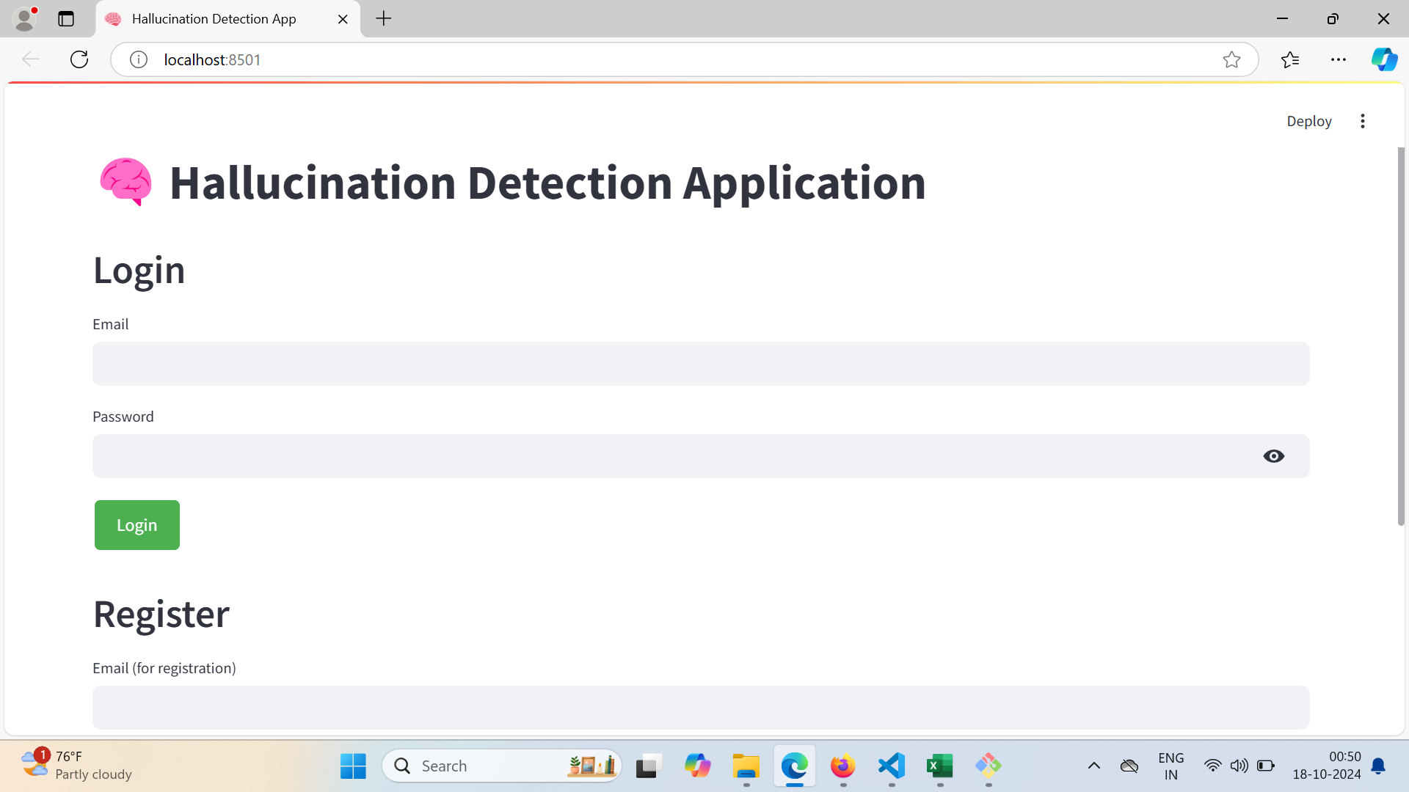
SCREENSHOTS

Slide 15
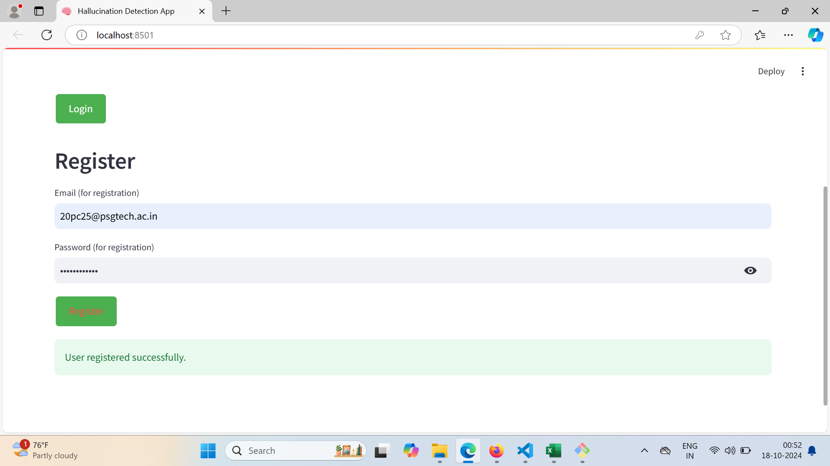

Slide 16
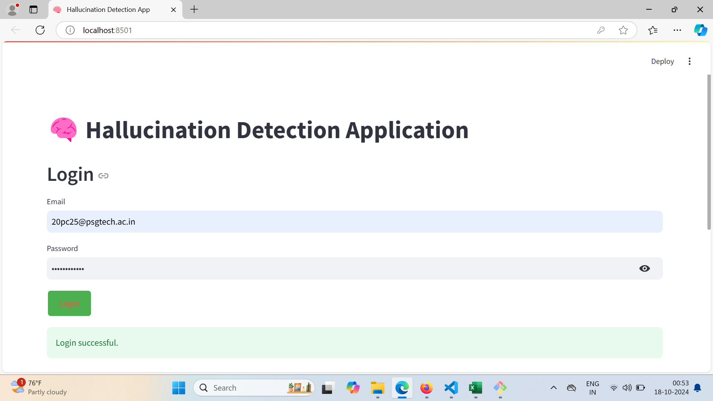

Slide 17
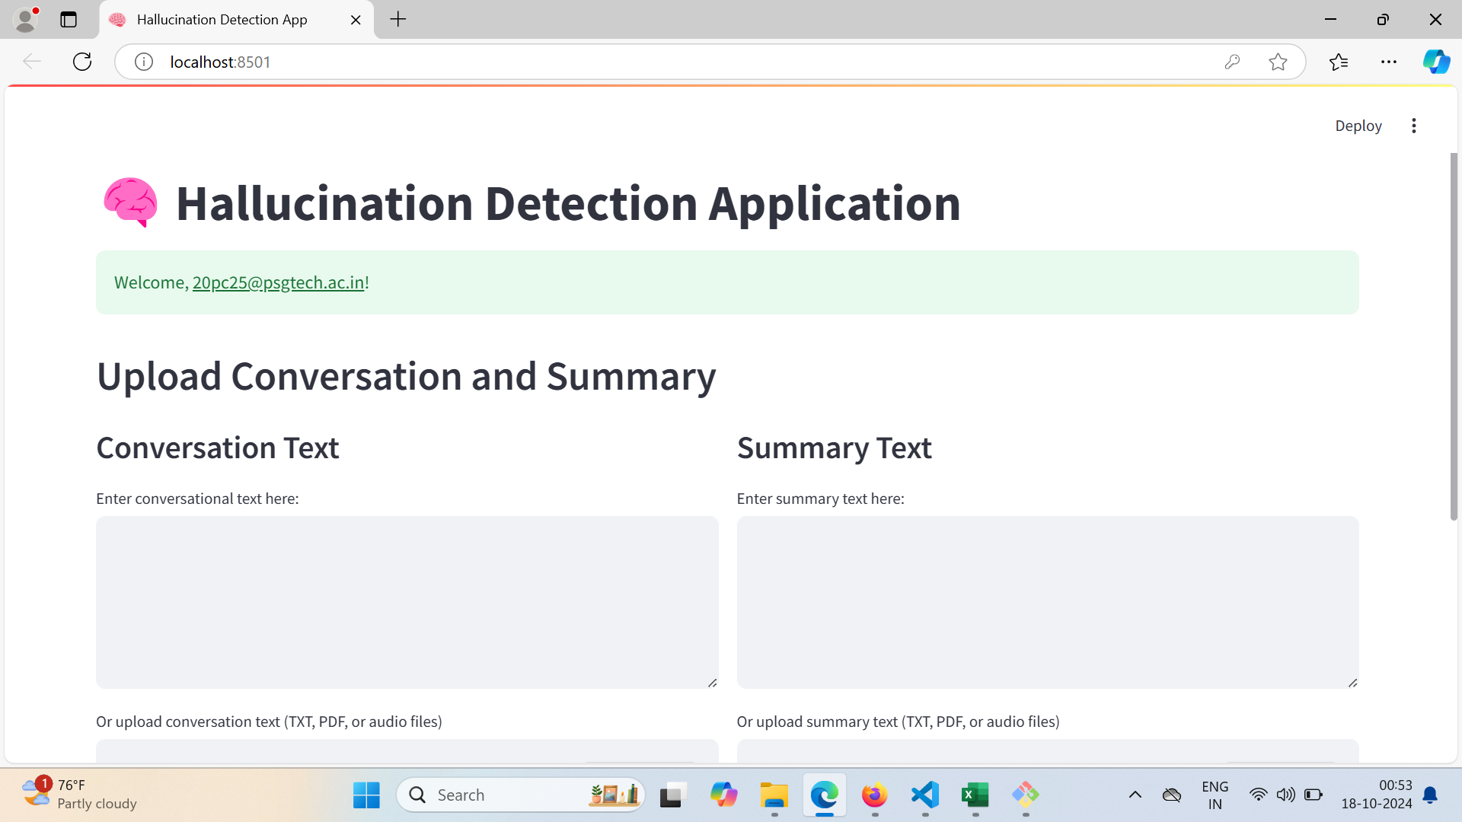

Slide 18
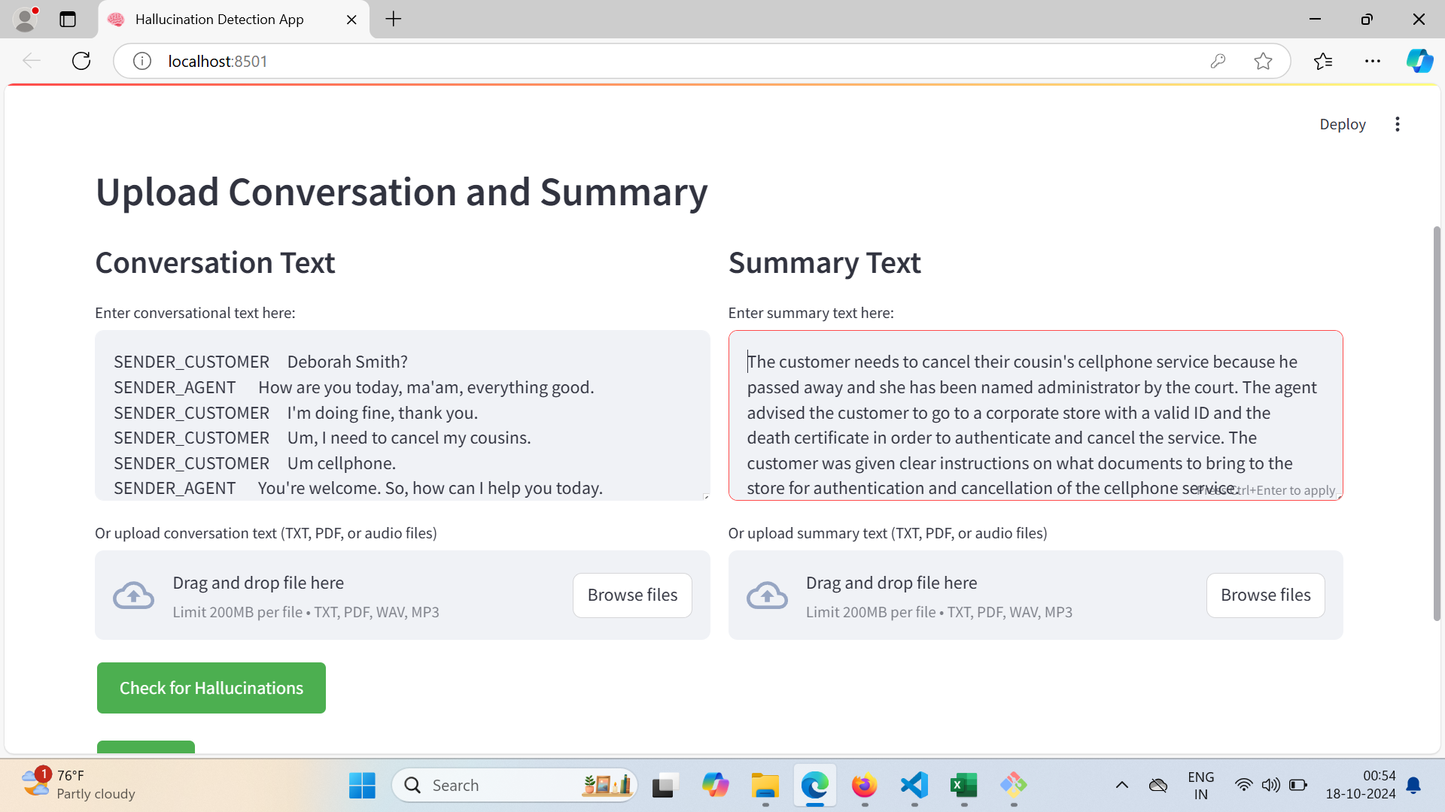

Slide 19
